Slide 1

FUNCTIONALITY
Addition
Subtraction
Multiplication
Division
Exponentiation
Root
Pi constant
Euler's number
Sine
Cosine
Tangent
Cotangent

Slide 2
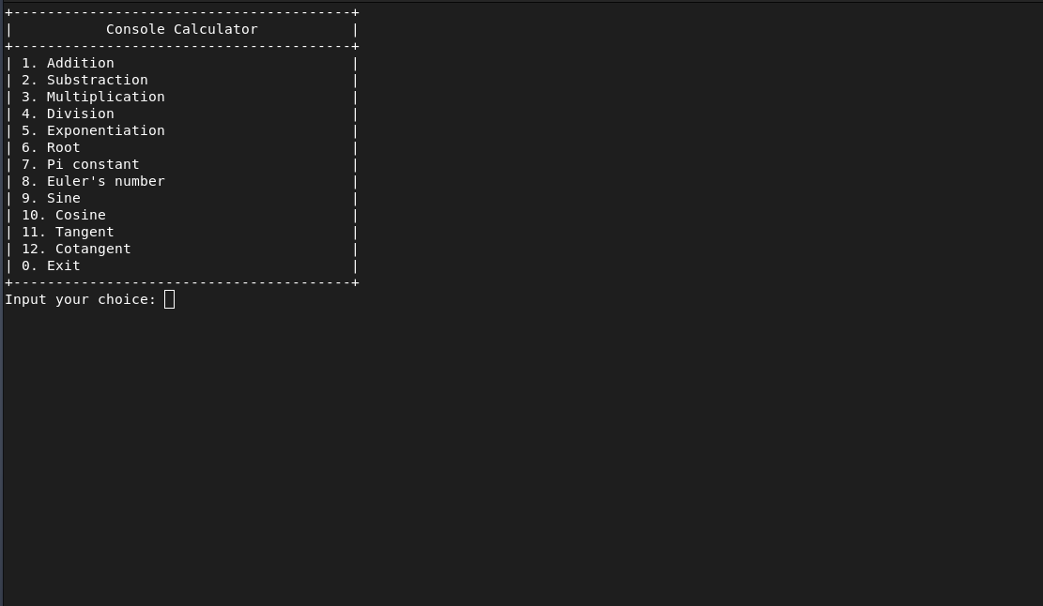
Console

Slide 3
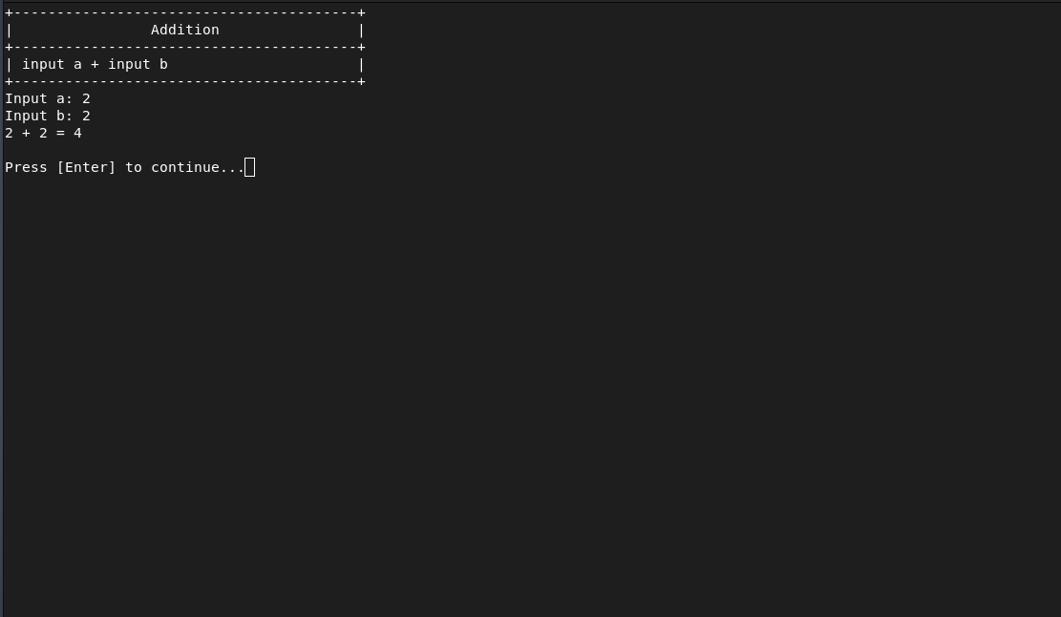
ADDITION

Slide 4

SUBTRACTION

Slide 5

MULTIPLICATION

Slide 6
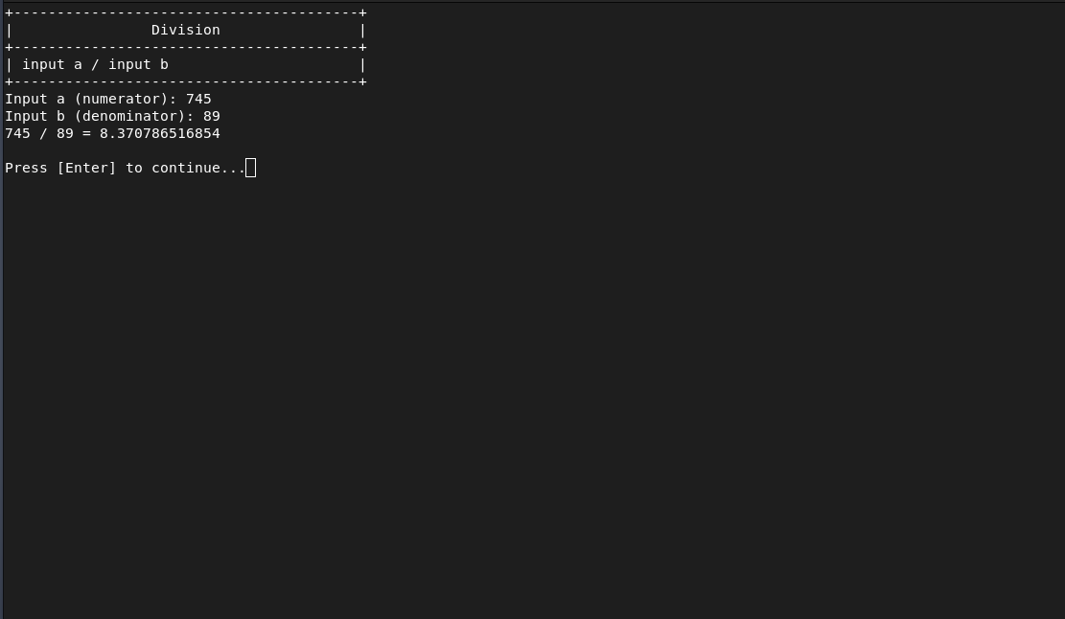

DIVISION

Slide 7
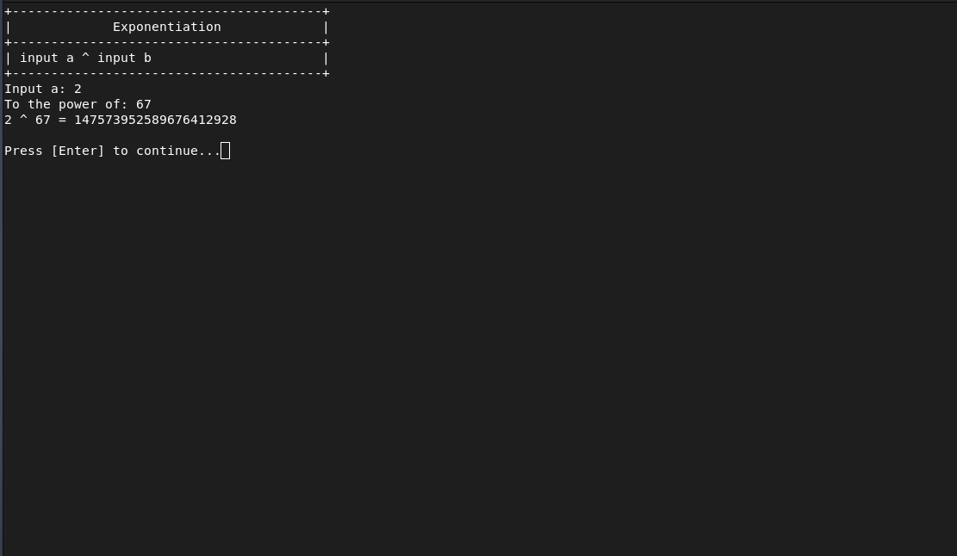

EXPONENTIATION

Slide 8
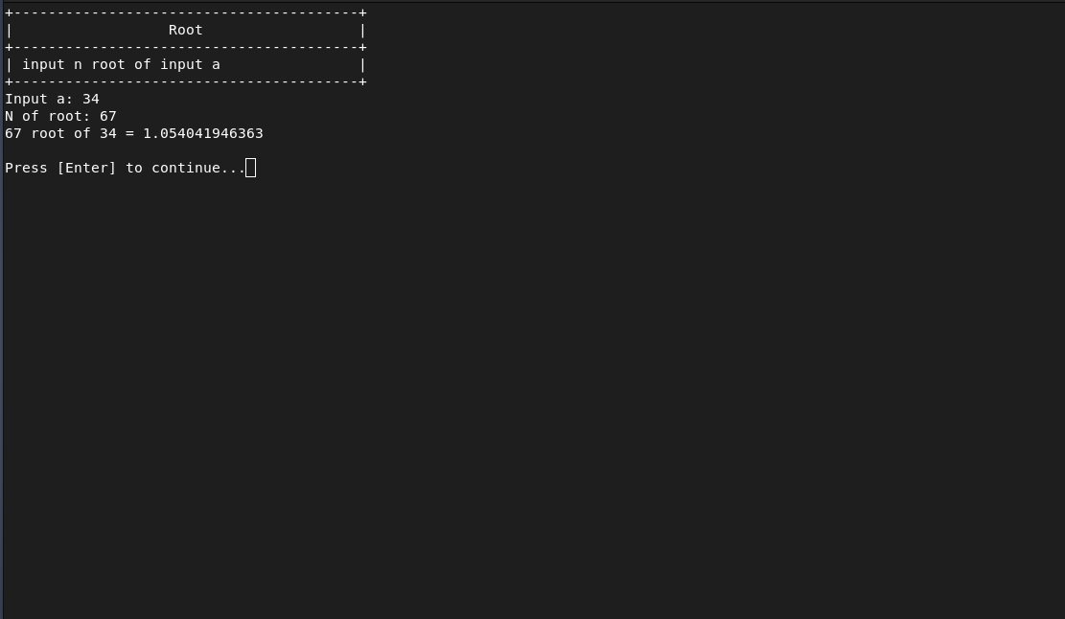

ROOT

Slide 9
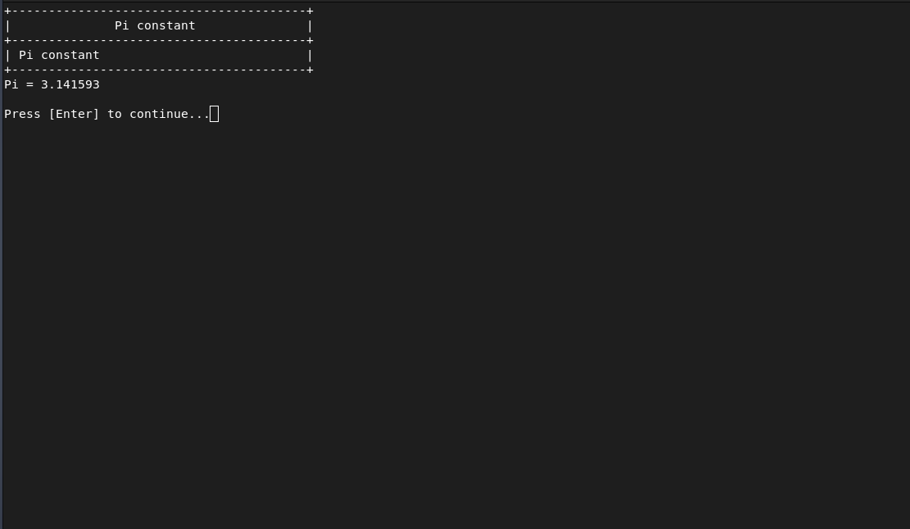
PI CONSTANT

Slide 10
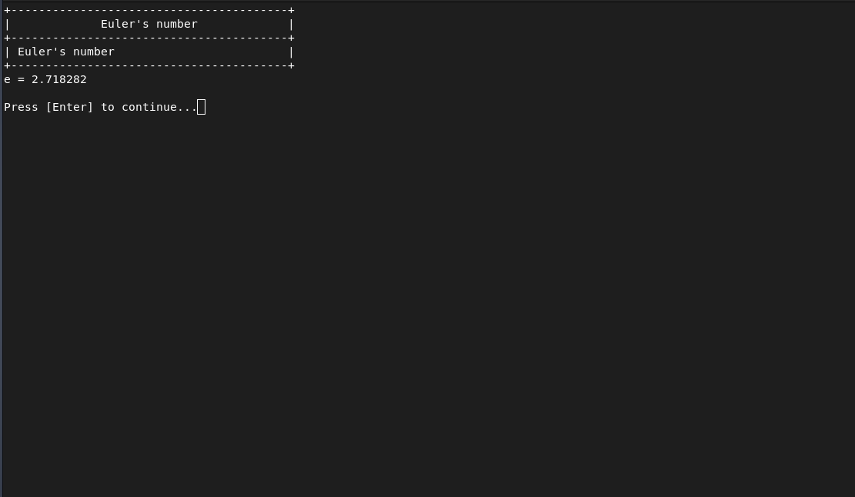
EULER’S NUMBER

Slide 11
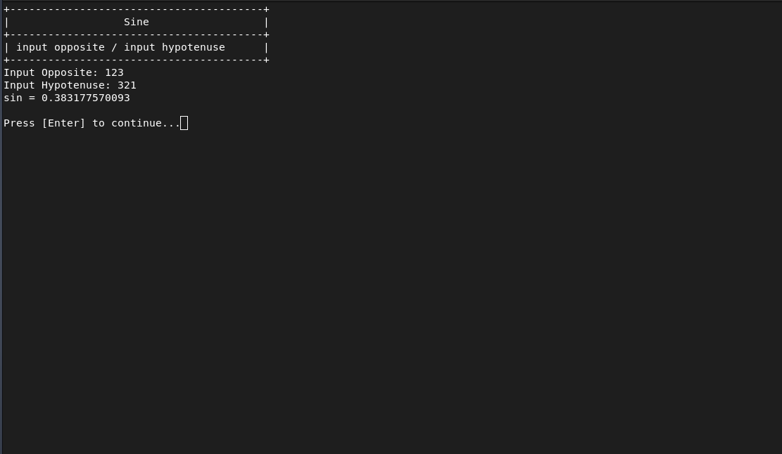
SINE

Slide 12
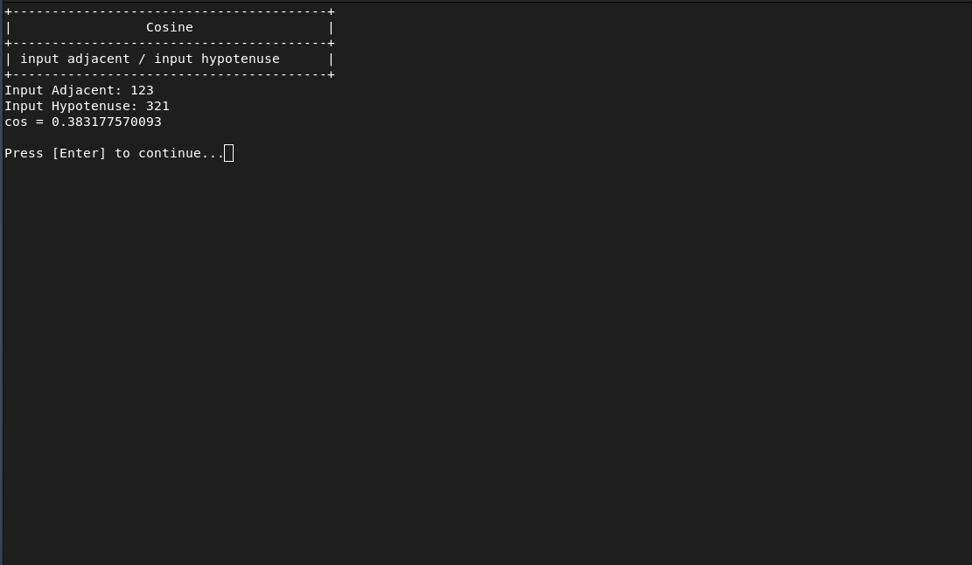
COSINE

Slide 13

TANGENT

Slide 14

Cotangent

Slide 15


